Slide 1
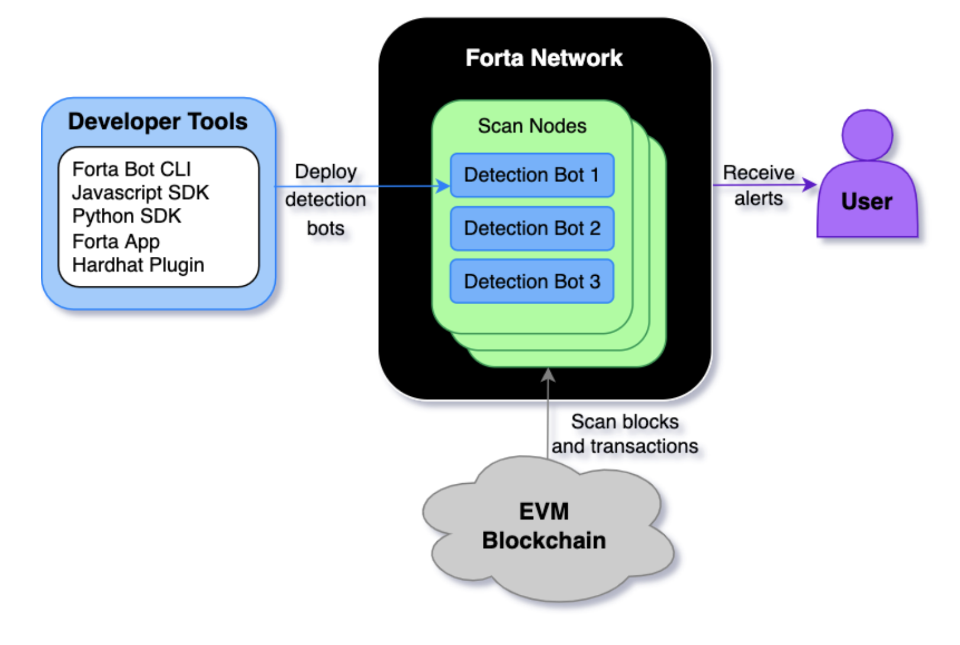
This and ether.js is all we need to use

Slide 2
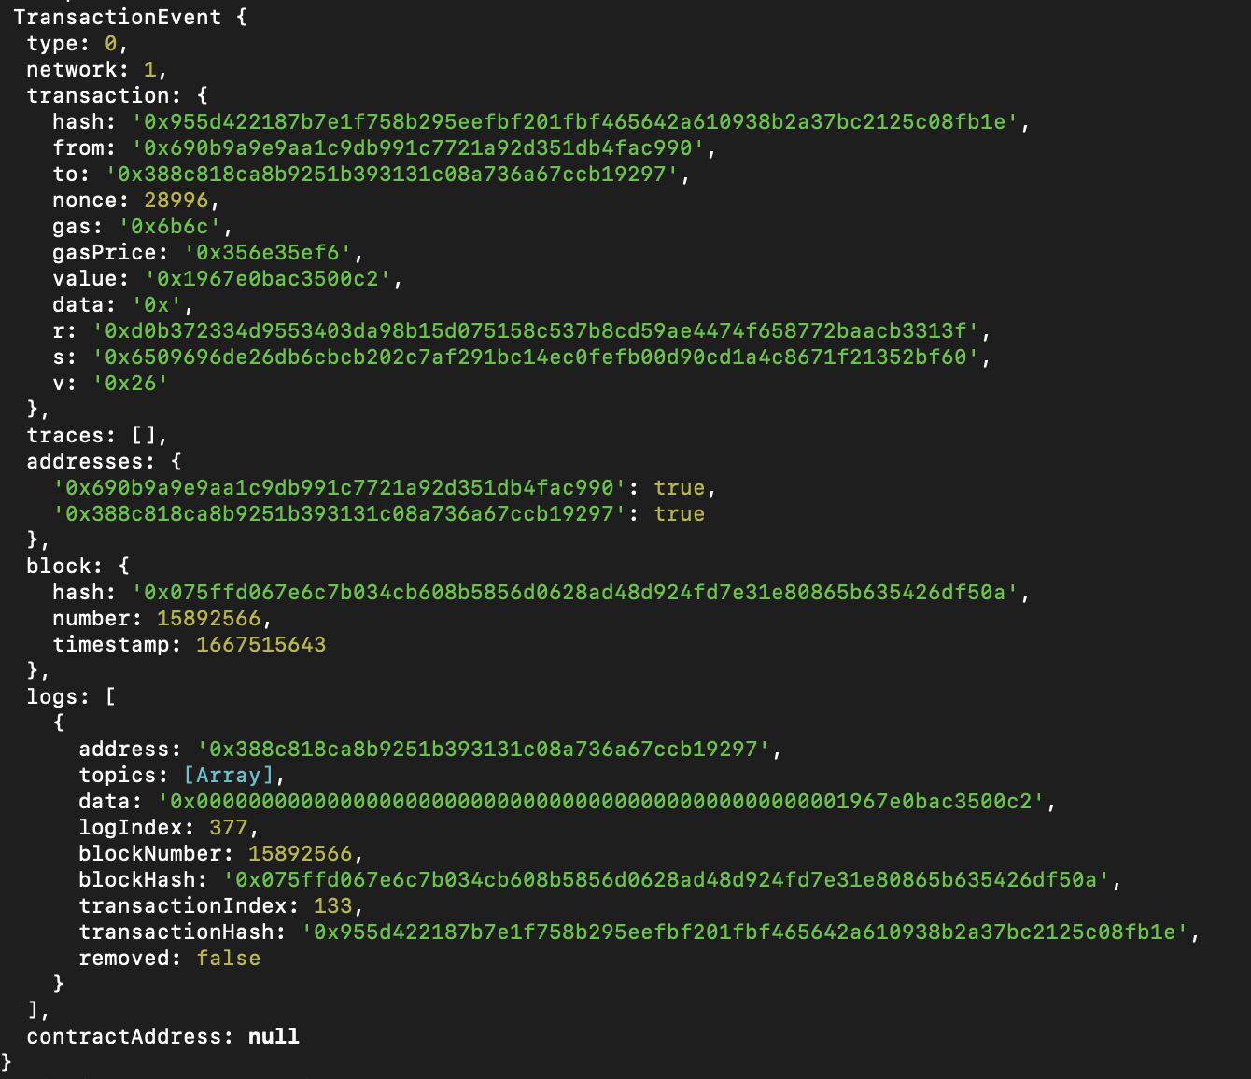

Slide 3
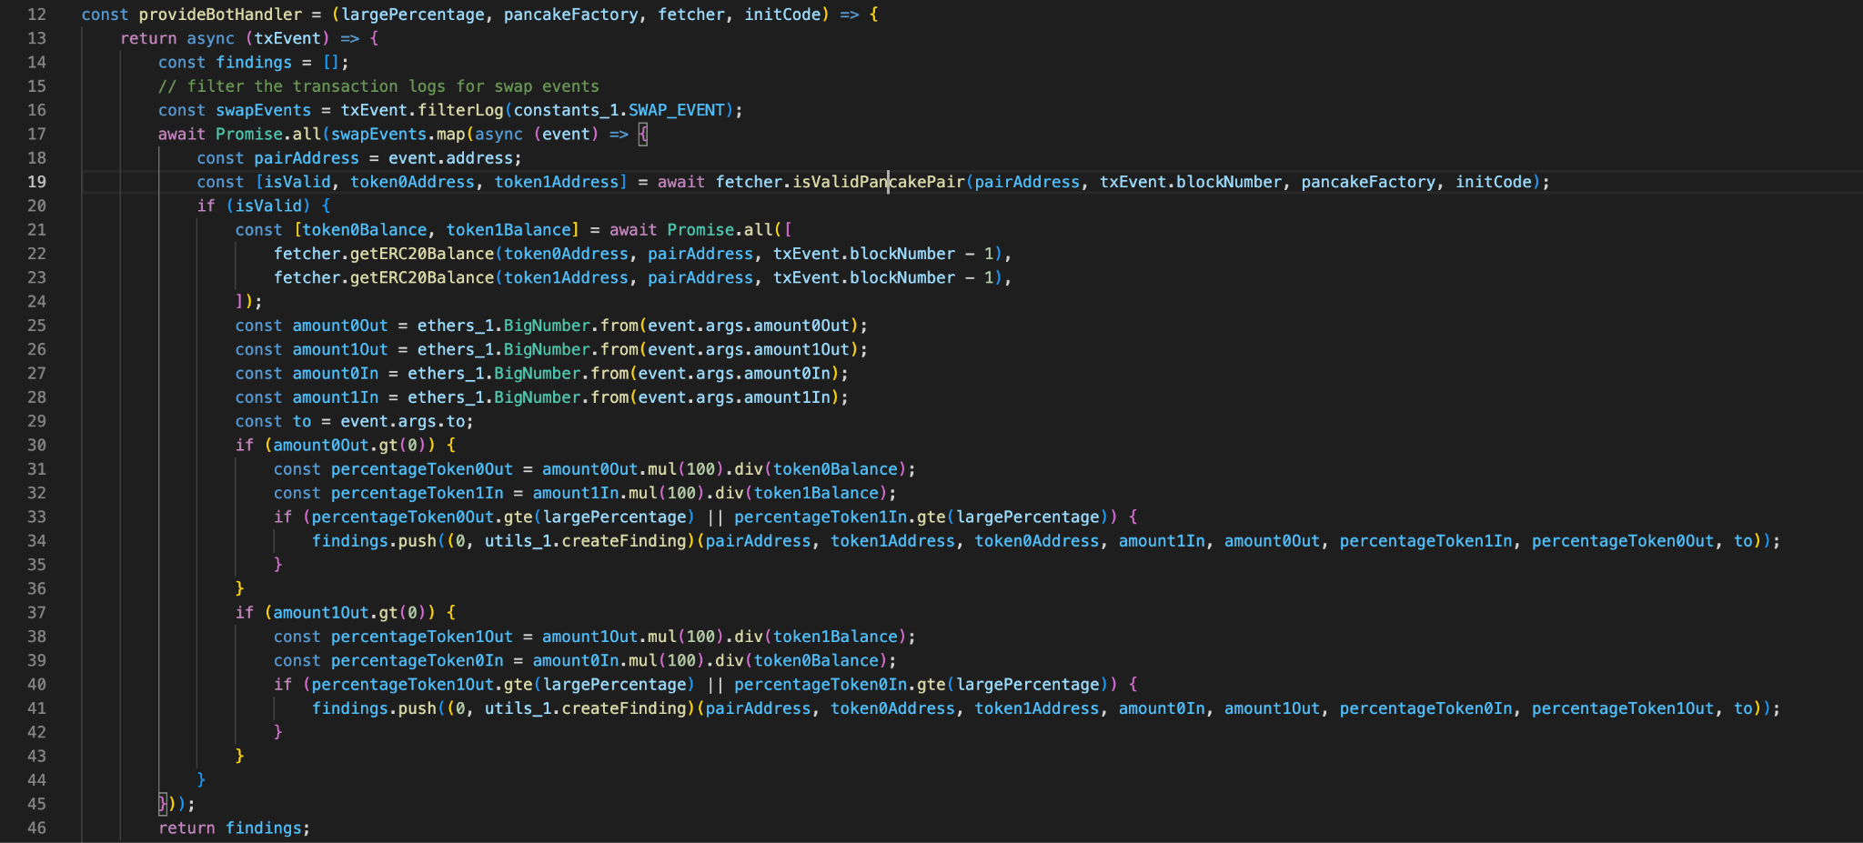

Slide 4
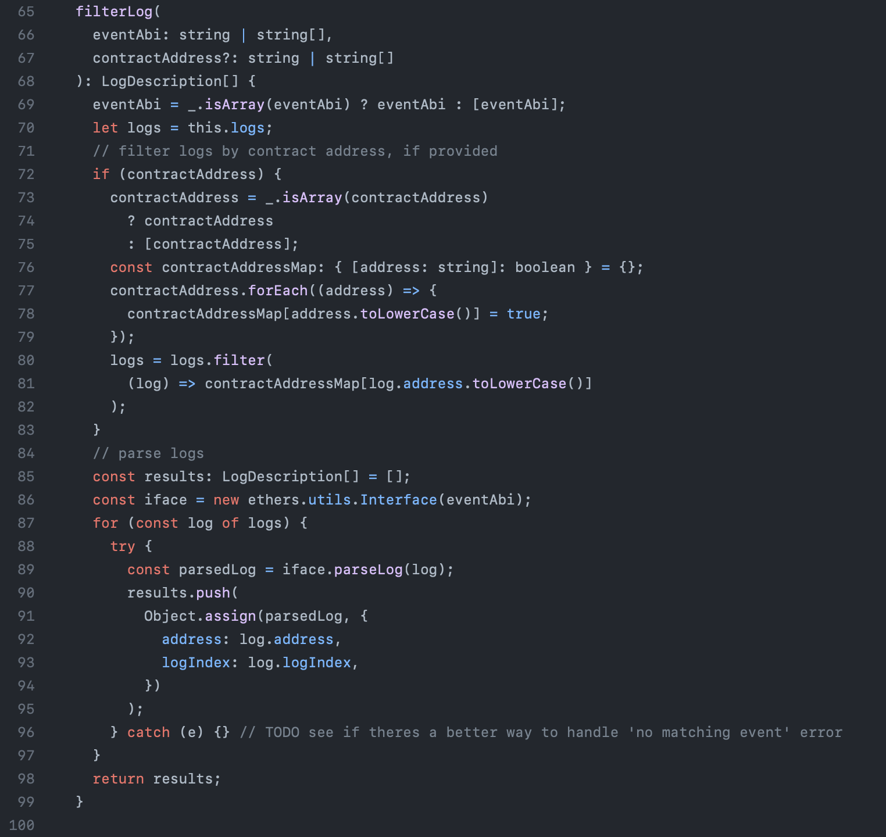
forta-bot-sdk
https://github.com/forta-network/forta-bot-sdk/blob/master/sdk/transaction.event.ts

Slide 5
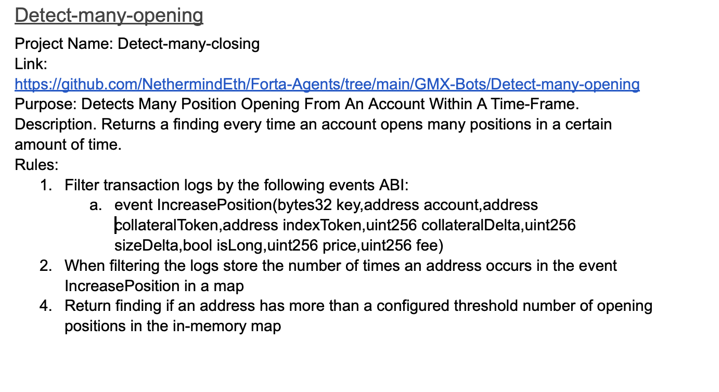

Slide 6
